Slide 1
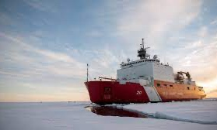
ADAC Year 8 Annual Meeting
...Via Conference Call, 20-21 April 2022
ADAC Project Briefing
Arctic Ice Condition Index
Jifeng Peng, University of Alaska Anchorage
Shawn Butler, University of Alaska Anchorage
Jinlun Zhang, University of Washington
Kelsey Frazier, University of Alaska Anchorage

Slide 2
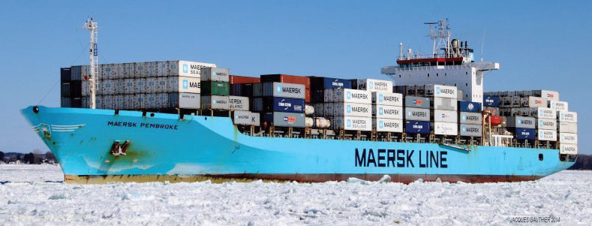
ADAC Program Year 8 Annual Meeting 19-20 April 2022
Arctic Ice Conditions Index (ARCTICE)
Expert Advisors
Project Champions
  CDR Christopher Tuckey,
  CG-WWM
Project Support
  Sam Cheung, CG RDC
Project Collaborators
  Jonathan Edwards-Opperman, NIC
  Capt. (Ret) Phillip Thorne, CG D17
  Axiom Data Science
USNIC Scientists
  Sofia Montalvo
  Michael Lowe
  Bailey Miller from USNIC

Slide 3
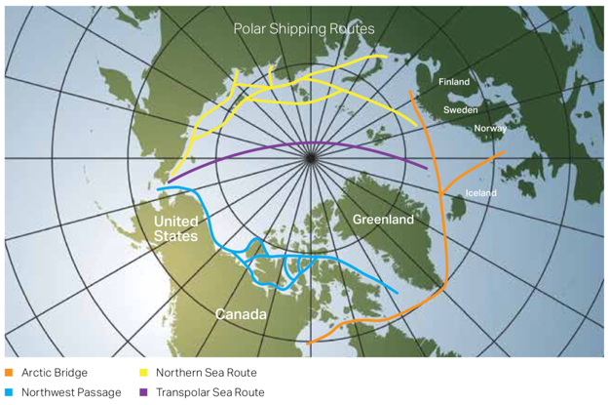
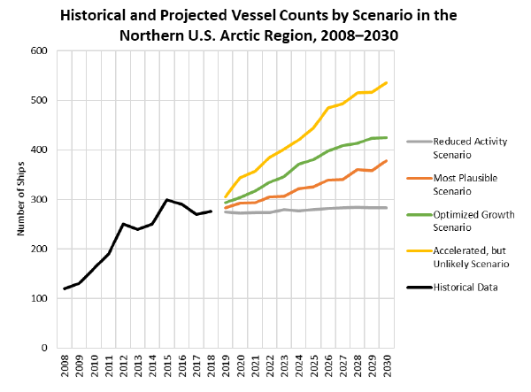
ADAC Program Year 8 Annual Meeting 19-20 April 2022
Arctic Ice Conditions Index (ARCTICE):
Relevance to DHS and USCG
Retreating sea ice has increased Arctic shipping and transportation viability
Polar shipping routes
From U.S. Committee on the Marine Transportation System

Slide 4
ADAC Program Year 8 Annual Meeting 19-20 April 2022
Arctic Ice Conditions Index (ARCTICE)
Relevance to DHS and USCG
Ship Traffic
Situational Awareness
LNG
Tourism
Exploration
Deterrence
Comms
Risks
SAR
Ice Conditions
There is no current publication of the severity of ice conditions and associated risk related to specific vessel classes
In order to ensure the safety and security of the vessels, personnel, and the environment, it is important to develop a high resolution ARCTICE to support Arctic mariner decision making
Notes:
Exponential increases in ship traffic through US Arctic EEZ
Foreign industry is transporting LNG through Chukchi and Bering Sea year round, attracting interest from other companies and nations
Arctic mariners experience long distances between ports of call, communication shortfalls, increasingly unpredictable weather patters, and limited USCG SAR availability
Vessels historically have travelled through the ice without knowledge of potential risks from the sea ice, sometimes getting stuck and needing assistance
There is no current publication of the severity of ice conditions and associated risk related to specific vessel classes
In order to ensure the safety and security of the vessels, personnel, and the environment, it is important to develop a high resolution ARCTICE to support Arctic mariner decision making

Slide 5
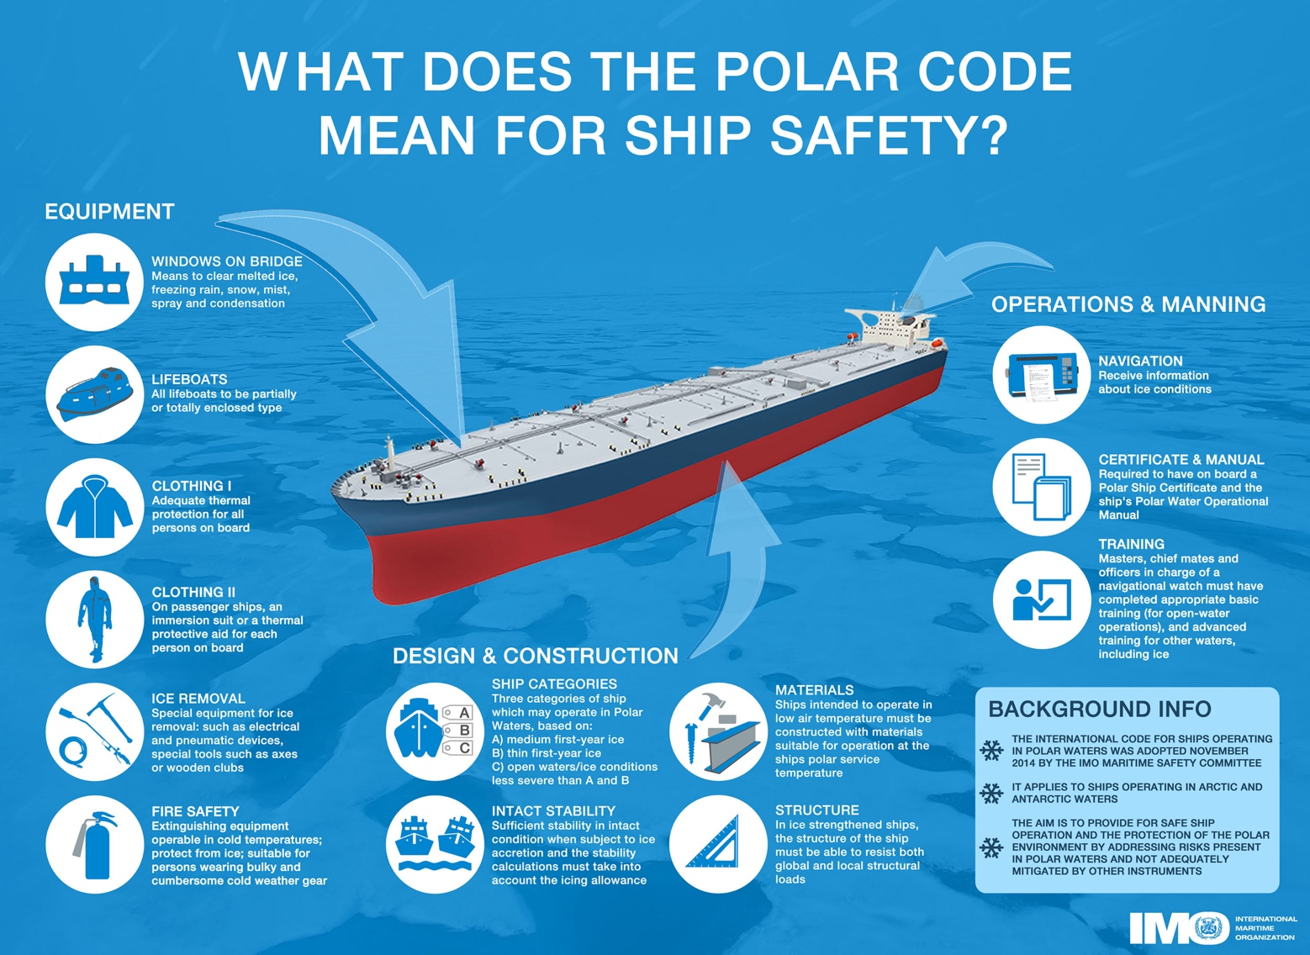
ADAC Program Year 8 Annual Meeting 19-20 April 2022
Arctic Ice Conditions Index (ARCTICE)
Description and Baseline
Leveraging team and research skills which developed Great Lakes ICECON, project ARCTICE will develop a high-resolution ice condition index for U.S. Arctic Maritime Exclusive Economic Zone (EEZ), including Bering, Chukchi and Beaufort Sea regions
ARCTICE produces an easy-to-understand numeral to communicate ice conditions that are relevant to the capabilities of an individual vessel. This index will be available for current and future ice conditions, providing forecasts up to 1 month in advance
ARCTICE supports vessel captains and officers in route planning and determining associated risk for traveling through a region of Arctic water

Slide 6
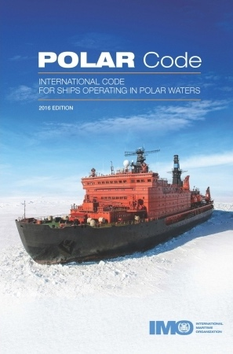
Arctic Ice Conditions Index (ARCTICE)
Description and Baseline
ADAC Program Year 8 Annual Meeting 19-20 April 2022
Historically many Arctic nations use their own methods for communicating ice conditions. Following the addition of the “POLARIS amendment” to the International Maritime Organization (IMO) Polar Code, communication tools on ice conditions started to migrate to a uniform methodology.
The POLARIS amendment to the IMO Polar Code is based on vetted ice condition processes from the Canadian AIRSS system, the Russian Ice Certificate concept, and additional inputs from other coastal administrators.
While the IMO has no existing or planned international enforcement privileges, the IMO Polar Code is seen as a “best practices” guide, many nations require that vessels comply with the Polar Code.

Slide 7
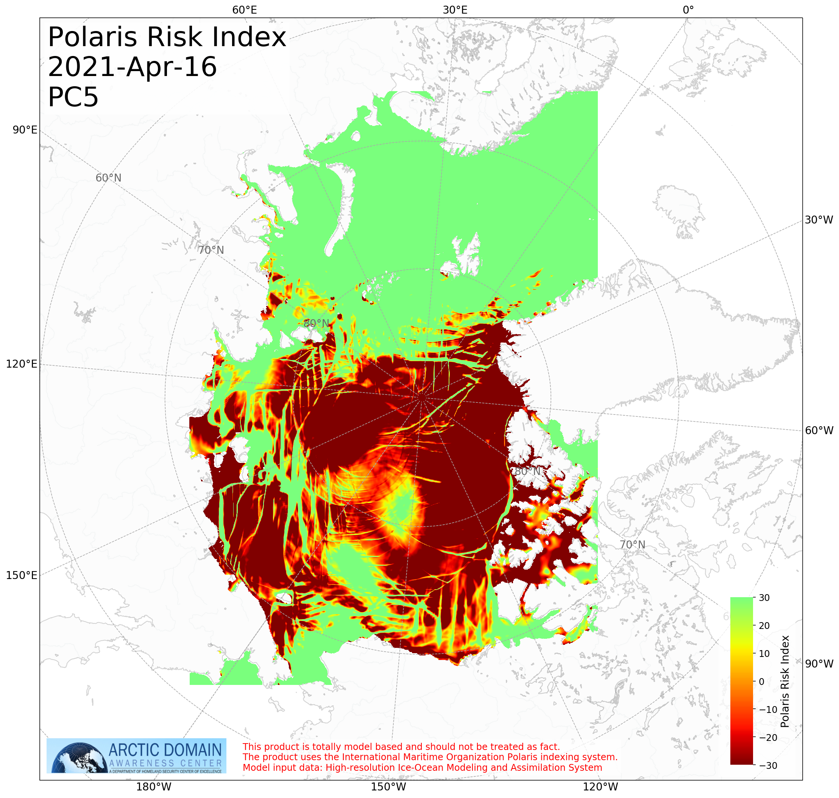
ADAC Program Year 8 Annual Meeting 19-20 April 2022
Arctic Ice Conditions Index (ARCTICE)
Prior Work Completed
Provide and confirm the ARCTICE vessel classification index;
Investigate other national models (in particular, Canadian programs)
Determine suitable environmental factors;
Integration of the index to a visualization tool as an aid to vessel mariner planning and underway activities;
Transition the ARCTICE to an operational destination.

Slide 8
ADAC Program Year 8 Annual Meeting 19-20 April 2022
Arctic Ice Conditions Index (ARCTICE)
Project year 8 workplan
Task 1: Finalize the validation efforts for the ARCTICE algorithm. Completed.
Task 2: Increase the accessibility of ARCTICE products. Completed.
Task 3: Transition the ARCTICE to an operational destination. Partially Completed.
Task 4: Investigate application of ARCTICE RIO charts to forecast Bering Strait traffic bound for a future Arctic Port in Nome, AK. Completed.

Slide 9
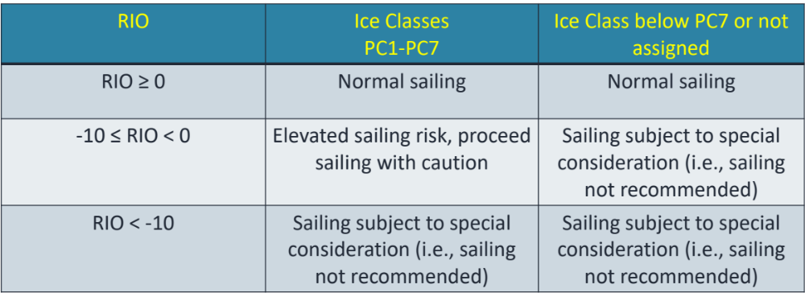
ADAC Program Year 8 Annual Meeting 19-20 April 2022
Arctic Ice Conditions Index (ARCTICE)
Project year 8 workplan
  Task 1: Finalize the validation efforts for the ARCTICE algorithm.
  Received part of the ice data from USNIC on board Healy (acknowledgement to Sofia Montalvo, Michael Lowe and Bailey Miller from USNIC);
  The accuracy of the ARCTICE model was evaluated based on the 3 ranges of RIO values listed in Table 1. The accuracy of the ARCTICE model depends on the ship ice class.
For more ice-capable ships such as Healy, the model is accurate and indicated ‘normal sailing’ on all recorded locations.
However, the input data used for the ARCTICE model sometimes underestimates the ice thickness, especially in the marginal ice zones, and therefore creates some discrepancies of RIO value for less ice-capable ships.
For example, using the same data from Healy, the ARCTICE model accuracy is only 72% for an PC7 (least ice capable) ship.

Slide 10
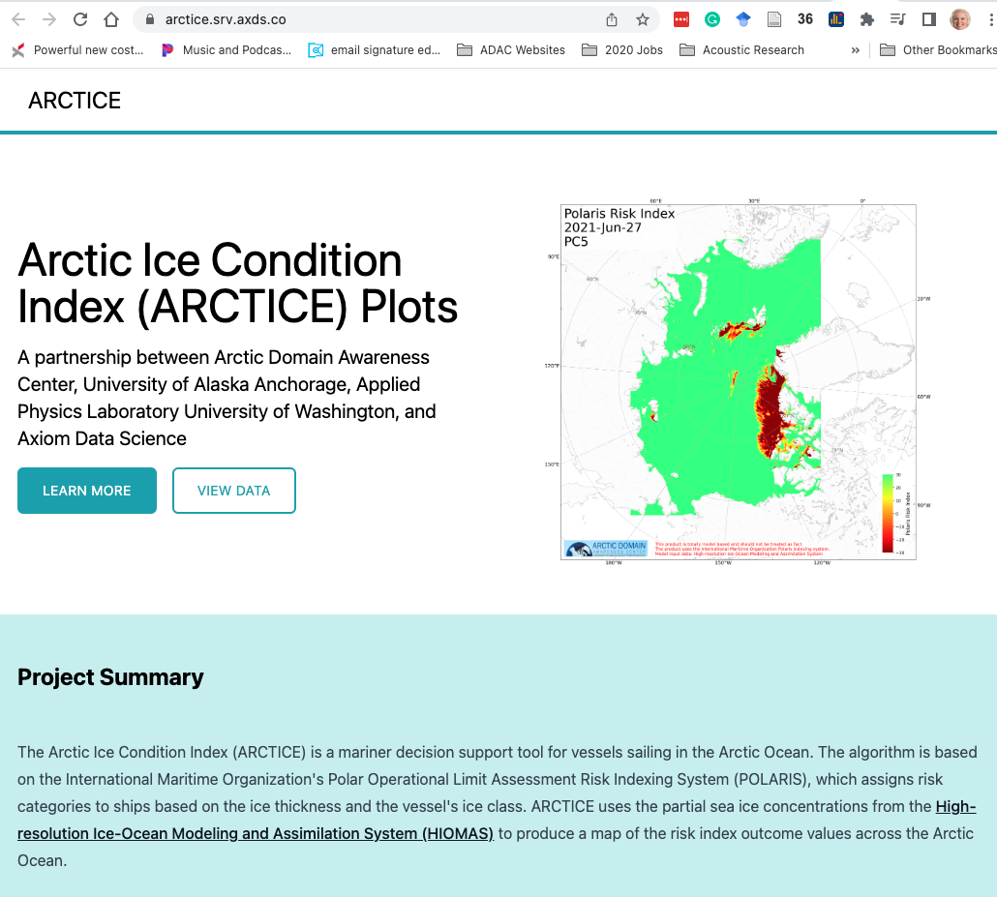
ADAC Program Year 8 Annual Meeting 19-20 April 2022
Arctic Ice Conditions Index (ARCTICE)
Project year 8 workplan
Task 2: Increase the accessibility of ARCTICE products
The research team, alongside Axiom employees, investigated ease of access and built a front-facing website for the products aimed for on-board and mobile device usage.
The website is https://arctice.srv.axds.co/. The website also includes instructions for users to easily use the product.
Another value-added element proposed is the inclusion and offering of ArcGIS capable data sets allowing onshore use such as route planning.

Slide 11
ADAC Program Year 8 Annual Meeting 19-20 April 2022
Arctic Ice Conditions Index (ARCTICE)
Project year 8 workplan
Task 3: Transition the ARCTICE to an operational destination
ARCTICE is operational and maintained by Axiom Data Science
Final federally-owned operational destination is currently under discussion. Working to maintain longevity of the system.

Slide 12
ADAC Program Year 8 Annual Meeting 19-20 April 2022
Arctic Ice Conditions Index (ARCTICE)
Project year 8 workplan
Task 4: Investigate application of ARCTICE RIO charts to forecast Bering Strait traffic bound for a future Arctic Port in Nome, AK
Investigated application of ARCTICE RIO charts to forecast Bering Strait traffic bound for a future Arctic Port in Nome, AK:
  Analyzed ARCTICE data for year 2021 at Bering Strait;
  The days of safe passage at Bering Strait in year 2021 for various ice class vessels are listed in Table.
Vessel ice class | PC1 | PC2 | PC3 | PC4 | PC5 | PC6 | PC7 | 1A super | 1A | 1B | 1C
Days for safe passage in 2021 | 365 | 365 | 365 | 365 | 365 | 362 | 359 | 352 | 317 | 275 | 254

Slide 13
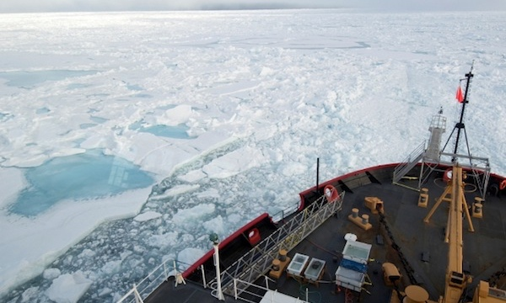
ADAC Program Year 8 Annual Meeting 19-20 April 2022
Ready for Questions
Feedback…
What are we missing?
What can we improve?
Who should we connect with to improve odds of research success?
Notes:
Thank you for the gift of your time and attention.

